Slide 1
Distribution of Malware via GitHub
The Amadey Incident
Name: Ana Duarte Amorim
edX username: anaam_8
GitHub: @amrmaa
Country: Portugal
01/08/2025

Slide 2
Hackers Use GitHub Repositories to Host Amadey Malware and Data Stealers, Bypassing Filters
In April 2025, a real-world cyberatack was discovered
Threat actors used public GitHub repositories to host and distribute malware
Bypass traditional security filtes, like antivirus and web filtering
Fake GitHub accounts uploaded malware disguised as legitimate files
Malware loader downloaded additional, more dangerous payloads
Part of a broader trend: Malware-as-a-Service (MaaS)
2

Slide 3
Technologies Involved
GitHub – used to host and distribute malware
Trusted domain helped bypass detection
Emmenhtal (or PEAKLIGHT) – loader malware
Downloaded and executed Amadey
PowerShell – used in malicious scripts
Downloaded payloads from hardcoded IPs
3

Slide 4
Technologies Involved
Amadey – modular Trojan
Collects system info and credentials
Supports plug-ins
LockBit 3.0 – ransomware
Encrypts files and demands ransom
Lumma Stealer & RedLine Stealer – info stealers
Extract browser data, saved passwords, autofill
4

Slide 5
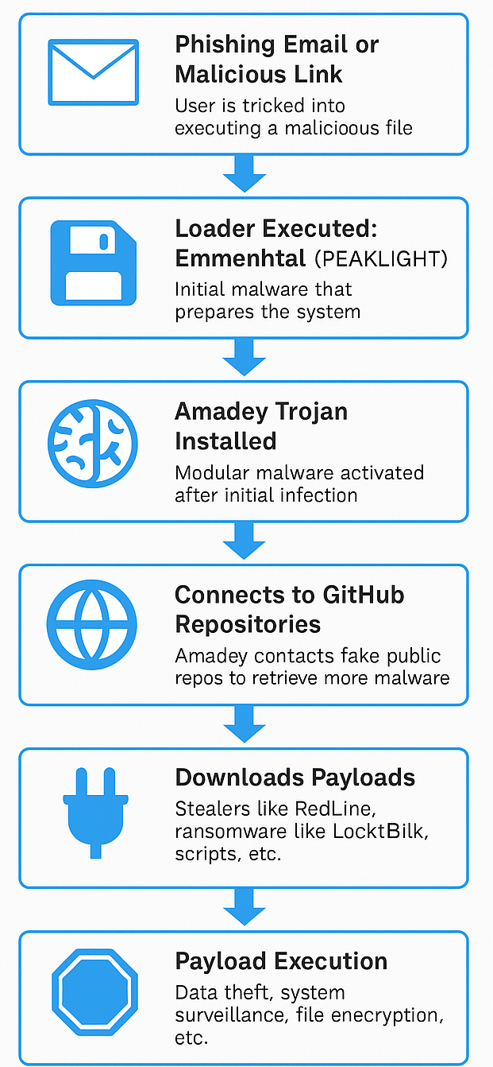
Attack Chain
5

Slide 6
Impact of the Attack
Cisco Talos discovered the campaign early, but GitHub’s public nature made detection harder.
Main victims: individuals and small to mid-sized companies
Attack tools can scale. Similar campaigns targeted entities in Ukraine
Potential for global impact, due to abuse of trusted platforms
6

Slide 7
Impact of the Attack
Erosion of trust in public platforms like GitHub
Limitations of traditional antivirus
MaaS groups becoming more scalable and stealthy
GitHub removed accounts, but incident shows need for continuous monitoring and stronger content validation
7

Slide 8
How Could This Attack Have Been Prevented?
GitHub must play a central role in prevention due to its abuse as a malware host.
Automatically flag accounts uploading executables or scripts commonly used in malware.
Monitor download behavior and detect repositories accessed by malware-like patterns.
Enforce stronger identity verification for users uploading executable content, to reduce fake or malicious profiles.
8

Slide 9
How Could This Attack Have Been Prevented?
User awareness is critical — many attacks begin with human error
Train users to recognize phishing emails, fake invoices, and suspicious download prompts
Verify the source of downloaded files, even from trusted platforms like GitHub
Avoid unnecessary admin privileges — users should not have admin rights unless required, to reduce the potential impact of malware
9

Slide 10
How Could This Attack Have Been Prevented?
Organizations can reduce the impact of attacks like this one by implementing multiple layers of security:
Monitor suspicious activity on trusted platforms like GitHub
Use EDR tools to detect malicious behavior such as loaders and trojans
Track PowerShell usage to block harmful scripts
Keep secure offline backups to recover from ransomware
This case reinforces the value of Defense in Depth, where no single measure is enough
10

Slide 11
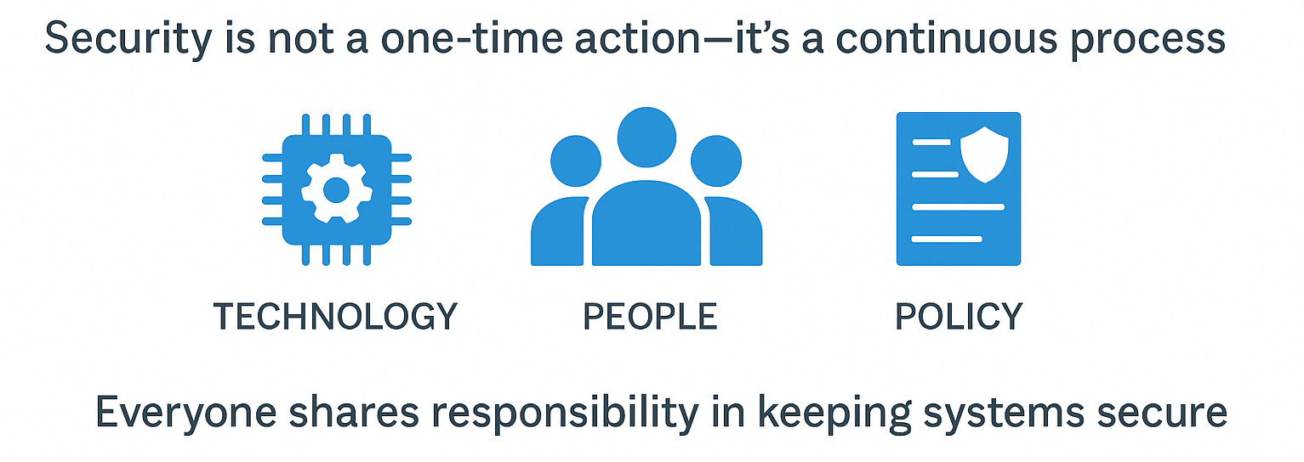
11

